Slide 1
DoppelFlow
Workflows built in your image.
Andrii Volotskov
Kyle Fitzpatrick Sergii Trotsenko Skyler Bissell

Slide 2

Market Trends
Agent frameworks emerged in 2023 and will begin to integrate deeply with real business workflows next year
Businesses at all levels have proven to be extremely eager to adopt AI solutions with valid use cases
Highly repetitive, boring tasks will be the first types of work to be automated at scale

Slide 3
Problem
Repetitive tasks are boring for workers and automating them is difficult and expensive.
Knowledge workers spend ~50% of their weekly time on repetitive tasks¹ We all know how fun that work can be…

Slide 4
Solution
Our workflows are the fastest way to train an AI doppelgänger for your repetitive tasks.
Here’s how it works:
Hit record and carry out any task you wish to automate
AI parses visual & code-based recording to create a workflow
Re-play this Doppel when needed, or share with a friend

Slide 5
Demo
Let’s have a look! 🤞😉

Slide 6
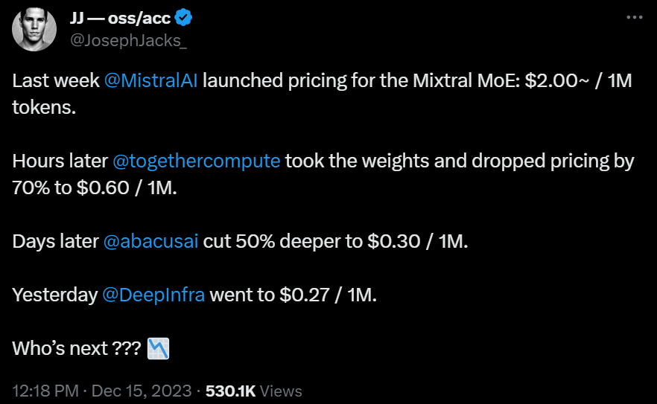
Two Risks to Address…
#1 – Privacy & Security
Remove malicious actors with KYC
Handle data privacy with open-source models & (optional) on-prem hosting
#2 – Compute Cost

Slide 7
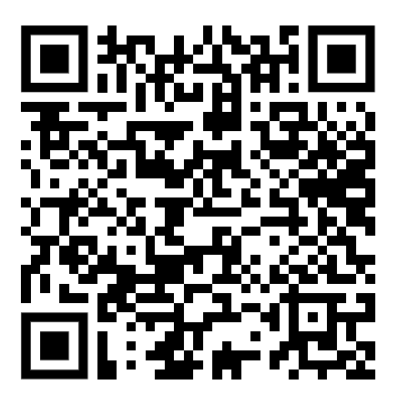
Thank you
Want to stay updated on our progress?

